Slide 1
2D MAZE
Khawla Khaled Alneyadi – 202212912
Salama Mohammed Alkaabi – 202211492
CSBP421 (51)
Instructor: Rafat Demseh

Slide 2
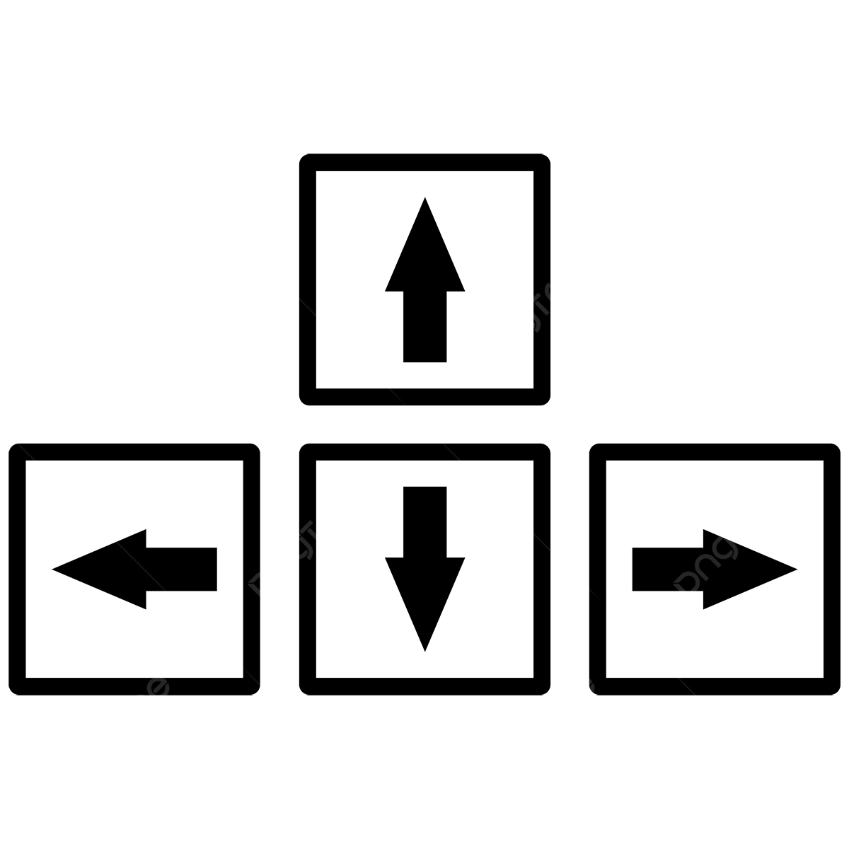
Introduction
Introduction:
Purpose: to create an interactive maze game that blends fun gameplay with key concepts of smart computer graphics. Scope: players navigate through the mazes, collect power-ups, and race against the clock, with increasing complexity and challenges as they progress through levels.
How the Game works:
Start the game on the home screen by choosing your character’s color and clicking the "Start Game" button.
Use the arrow keys to navigate through the maze, avoiding walls and finding the red goal.
Collect at least one yellow power-up before reaching the goal to complete the level.
If you miss a power-up, retry the level, and aim to finish all five levels within the time limits to win.

Slide 3
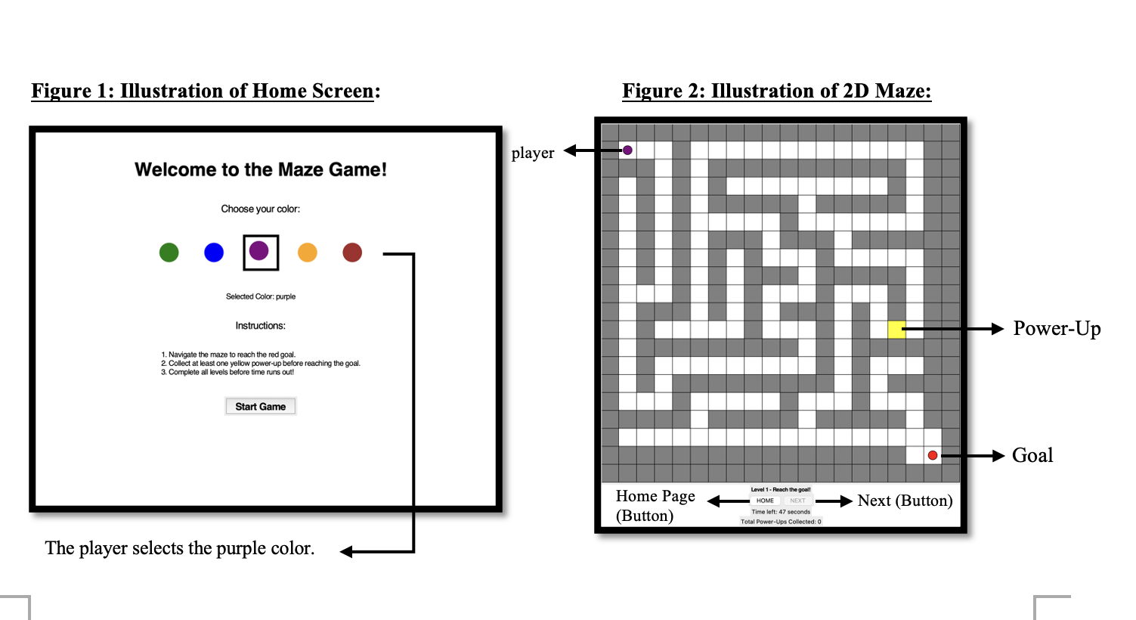
Methodology

Slide 4
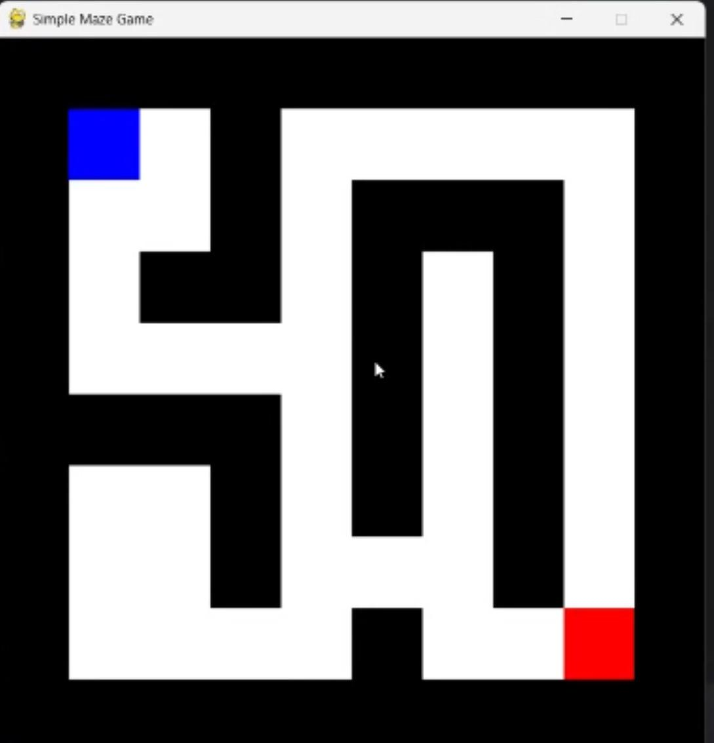
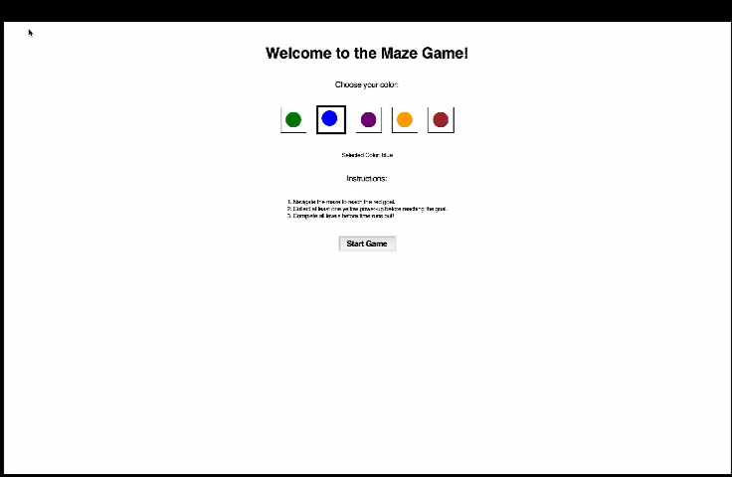
Gameplay Demonstration
Started with this
Modified & added:
Home screen + instructions
Player Colors
Home & next buttons
Timer + power-ups
Move step by step

Slide 5
Code
Tkinter Library: created the main applications eg: Frames, Labels, and Button.
Random: Adds randomness to maze generation.
Time: Keep track of time during the game.
_init_
create_home_screen
create_widgets
go_to_home
time_up
create_maze
generate_maze
add_extra_walls
ensure_goal_accessibility
draw_maze
move_player
is_solvable

Slide 6
Challenges & Conclusion
Overcame logic and syntax errors
Struggled with ensuring the maze was always solvable
Faced difficulties with changing the player’s color based on their choice.

